Slide 1
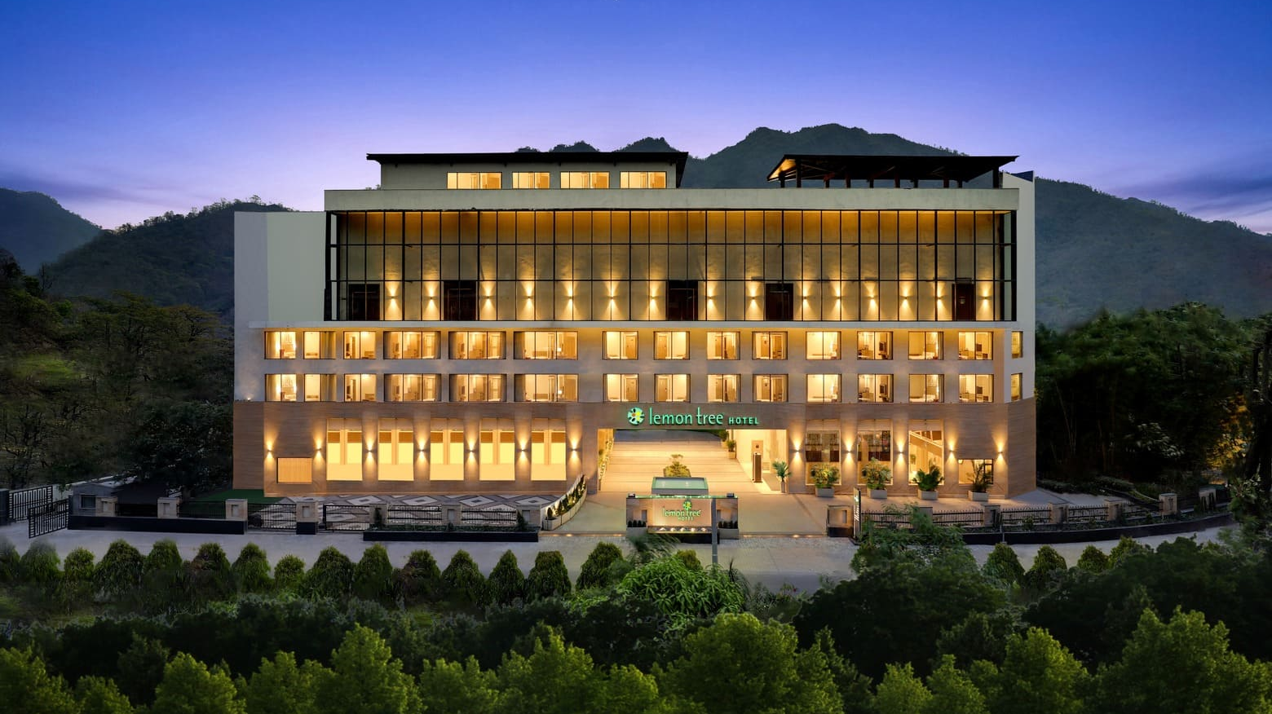

Hospitality Analysis
Codebasics resume challenge #1
Presented by: Dinesh Kumar S

Slide 2

AGENDA
COMAPANY OVERVIEW
PROBLEM STATEMENT
INSIGHTS
RECOMMENDATIONS

Slide 3
Company Overview
AtliQ Grands is a leading five-star hotel chain operating across major Indian cities such as Delhi, Mumbai, Bangalore, and Hyderabad. With over 20 years in the hospitality industry, AtliQ Grands specializes in two distinct hotel segments: business hotels, designed for corporate travelers, and luxury hotels, offering premium experiences for leisure guests. Each property features a variety of room classes
Elite
Standard
Premium
Presidential
tailored to meet the specific needs of its diverse clientele.

Slide 4
PROBLEM STATEMENT
AtliQ Grands, with over two decades of experience in the hospitality industry, is now facing significant challenges. Due to strategic moves from other competitors and ineffective decision-making in management, AtliQ Grands is losing its market share and revenue in the luxury/business hotels category. As a strategic move, the Managing Director of AtliQ Grands wanted to incorporate “Business and Data Intelligence” to regain their market share and revenue. However, they do not have an in-house data analytics team to provide them with these insights. Their revenue management team has decided to hire a third-party service provider to extract valuable insights from their historical data.

Slide 5
INSIGHTS
Week 27 recorded the lowest revenue at ₹42.93 million. In contrast, Weeks 19, 20, 22, 24, 25, 28, and 29 each generated high revenue, approximately ₹139 million.
Elite room type contributed the highest revenue at ₹553.74 million (32.81%), whereas the Standard room type contributed the lowest at ₹305.64 million (18.11%) of the total revenue.
Weekdays generated significantly more revenue (₹1164 million) compared to weekends (₹524 million).
Atliq Exotica led in revenue with ₹316 million, followed by Atliq Palace at ₹300 million, while Atliq Seasons contributed the lowest at ₹65 million
Others (unknown platforms) were the top contributor with ₹690 million, followed by MakeYourTrip with ₹337 million, while direct offline bookings accounted for the lowest at ₹85 million.
Out of the total revenue generated of ₹1983 million, only ₹1687.8 million was realized, resulting in a loss of ₹295.2 million due to cancellations.
Mumbai generated the highest city-wise revenue at ₹660.64 million, while Delhi contributed the lowest at ₹290.92 million.

Slide 6
INSIGHTS
Luxury hotels generated the highest revenue at ₹1040.03 million, accounting for 62% of the total, while business hotels contributed ₹647.73 million, making up 38%.
Mumbai recorded the highest revenue in the luxury category with ₹408.21 million.
Occupancy was higher on weekends at 62.64% compared to 55.85% on weekdays.
Weekdays see a no-show rate of 5.08%, while weekends fare slightly better with a 4.89% no-show rate.
Atliq Seasons had the lowest average rating (2.3) and occupancy (44.57%), while Atliq Blu had the highest rating (4.0) and occupancy (61.92%), indicating a positive correlation between rating and occupancy.
Others (unknown channels) accounted for 40.9% of bookings, followed by MakeYourTrip at 20%, with direct offline having the lowest share at 5%.
Elite rooms led with the highest booking share at 36.8%, whereas Presidential rooms had the lowest at 11.9%.
Atliq Exotica, Mumbai (Property ID: 16559) and Atliq Bay, Hyderabad (Property ID: 18562) recorded the highest DBRN of 80, while Atliq Grands, Delhi (Property ID: 16558) had the lowest at 34.

Slide 7
RECOMMENDATION
Focus Marketing On High-Performing Weeks Promote and replicate the strategies used in Weeks 19, 20, 22, 24, 25, 28, and 29 across other low-performing weeks, especially Week 27 which had the lowest revenue.
Maximize Weekday Potential Weekdays bring in significantly more revenue than weekends. Implement targeted weekday packages for business travelers and offer early check-in / late check-out for extended stays.
Revive Underperforming Properties like Atliq Seasons With both the lowest revenue and lowest average rating, Atliq Seasons needs immediate attention—focus on service improvement, refurbishment, and online reputation management.
Leverage High-Growth Properties Atliq Exotica and Atliq Palace are revenue leaders. Analyze what’s working well there—whether it's pricing, staff, amenities, or location—and replicate those practices across lower-performing hotels.

Slide 8
Improve Booking Platform Mix Unknown/Other platforms contribute 40.9% of bookings and the most revenue. Explore these sources to gain control and insights. Simultaneously, work to boost direct offline bookings through exclusive deals, loyalty programs, and seamless booking interfaces.
Address Revenue Leakage With ₹295.2 million in revenue lost, investigate causes like last-minute cancellations, Introduce strict cancellation policies.
Optimize Pricing Based on City Performance Mumbai contributes the most to revenue. consider dynamic pricing models for Mumbai and promotional pricing for cities like Delhi to increase their competitiveness.
Prioritize Luxury Segment The luxury category dominates both in revenue (₹1040.03M) and bookings (62.17%). Continue investing in this segment with premium experiences and high-end partnerships.
RECOMMENDATION

Slide 9
RECOMMENDATION
Leverage Customer Ratings for Revenue Growth High occupancy correlates with higher ratings. Focus on improving service quality at low-rated properties and actively collect feedback to push ratings above 4.0.
Platform Partnerships Strengthen relationships with top performers like MakeYourTrip. Negotiate better visibility or lower commission rates. Simultaneously, invest in improving the direct booking experience to reduce dependency on third-party platforms.
Rebalance Room Class Inventory With Elite rooms booking the most and Presidential rooms the least, evaluate whether some Presidential inventory can be reclassified or re-priced to drive better utilization.
Monitor Property-Level DBRN High-performing properties in terms of Daily Booked Room Nights (DBRN) should be used as benchmarks. Offer DBRN-based incentives to other properties to motivate performance.

Slide 10
Thankyou!
Dinesh Kumar S dinesh.works@gmail.com My Portfolio GitHub

